Slide 1
Customer Segmentation & Churn Pattern Analytics in European Banking Using Microsoft Power BI
Author: Sejal Singh Tool Used: Microsoft Power BI Dataset: European Bank Customer Churn Dataset Project Type: Business Intelligence & Customer Analytics

Slide 2
ABSTRACT
Customer churn is one of the most significant challenges faced by retail banks, as losing existing customers directly affects revenue, profitability, and long-term business growth. Identifying customer segments with a higher likelihood of churn enables banks to implement targeted retention strategies and improve customer satisfaction. This project analyzes customer churn patterns using a European banking dataset and develops an interactive dashboard using Microsoft Power BI.
The dashboard provides insights into customer behavior across multiple dimensions, including geography, gender, age group, tenure, account balance, and customer engagement. Key performance indicators (KPIs) such as Churn Rate, High-Value Churn Ratio, Geographic Risk Index, and Engagement Drop Indicator were developed using DAX measures to summarize customer retention performance.
The analysis reveals an overall churn rate of 20.37%, with customers from Germany, customers aged 46–60 years, and high-balance customers exhibiting relatively higher churn rates. Female customers also displayed a slightly higher churn rate than male customers. These findings highlight opportunities for targeted customer retention initiatives, improved engagement strategies, and personalized banking services.
The project demonstrates how Microsoft Power BI can transform raw customer data into meaningful business intelligence, enabling banks to make informed, data-driven decisions that improve customer retention and operational performance.
Keywords: Customer Churn, Power BI, Business Intelligence, Banking Analytics, Customer Segmentation, Data Visualization.

Slide 3
INTRODUCTION
The banking industry is becoming increasingly competitive due to rapid digital transformation, evolving customer expectations, and the availability of alternative financial service providers. As acquiring new customers is significantly more expensive than retaining existing ones, customer retention has become a strategic priority for financial institutions.
Customer churn refers to the percentage of customers who discontinue their relationship with a bank during a specific period. High churn rates reduce customer lifetime value, increase acquisition costs, and negatively affect profitability. Consequently, banks continuously monitor customer behavior to identify factors contributing to churn and develop proactive retention strategies.
Business Intelligence (BI) tools such as Microsoft Power BI provide organizations with powerful capabilities to analyze large datasets, visualize customer behavior, and support strategic decision-making. Through interactive dashboards, banks can identify customer segments with higher churn risk, compare regional performance, monitor key performance indicators, and gain actionable insights.
This project focuses on analyzing customer churn patterns within a European banking dataset. Using Microsoft Power BI, an interactive dashboard was developed to examine churn across multiple customer dimensions, including age, geography, gender, tenure, account balance, and customer engagement. The insights generated from this analysis can assist banking professionals in designing effective customer retention strategies and improving overall business performance.

Slide 4
PROBLEM STATEMENT
PROBLEM STATEMENT
Customer churn represents a major financial challenge for banks because it reduces recurring revenue, limits cross-selling opportunities, and increases customer acquisition costs. While banks collect extensive customer information, they often struggle to convert this data into actionable insights.
The absence of effective visualization and monitoring tools makes it difficult to identify high-risk customer segments and understand the factors contributing to customer attrition. As a result, many retention initiatives remain reactive instead of proactive.
This project addresses this challenge by using Microsoft Power BI to analyze customer churn patterns and identify the demographic, geographic, and behavioral characteristics associated with higher churn rates. The resulting dashboard enables decision-makers to monitor key performance indicators and develop data-driven customer retention strategies.

Slide 5
PROJECT OBJECTIVE
The primary objectives of this project are:
Analyse customer churn patterns within a European banking dataset.
Calculate and visualize key customer retention metrics using Power BI.
Identify customer segments with higher churn risk.
Compare churn rates across different geographical regions.
Analyse the influence of customer demographics on churn.
Evaluate customer engagement using activity and tenure information.
Develop an interactive dashboard for business decision-making.
Provide actionable recommendations to improve customer retention.

Slide 6
DATASET DESCRIPTION
The project utilizes a European banking customer dataset containing demographic, financial, and behavioural information for 10,000 customers. Each record represents an individual customer and includes attributes related to personal information, banking activity, and churn status.
Variable | Description
Customer ID | Unique customer identifier
Surname | Customer surname
Credit Score | Customer creditworthiness
Geography | Customer location (France, Germany, Spain)
Gender | Male or Female
Age | Customer age
Tenure | Years with the bank
Balance | Current account balance
Number of Products | Banking products used
Credit Card | Whether the customer owns a credit card
Active Member | Customer activity status
Estimated Salary | Annual estimated salary
Exited | Customer churn status (1 = Churned, 0 = Retained)

Slide 7
METHODOLOGY
METHODOLOGY
This project follows a Business Intelligence (BI) approach to analyse customer churn patterns using Microsoft Power BI. The methodology consists of data preparation, transformation, visualization, and business insight generation.
5.1 Data Collection
The analysis utilizes the European Bank Customer Churn Dataset, which contains demographic, financial, and behavioural information for 10,000 customers. The dataset includes customer attributes such as age, geography, credit score, account balance, number of products, customer activity status, and churn status.
The target variable used in the analysis is Exited, where:
0 = Customer Retained
1 = Customer Churned
5.2 Data Cleaning
Before visualization, the dataset was cleaned to improve accuracy and consistency.
The following preprocessing steps were performed:
Checked for missing values.
Removed duplicate records where necessary.
Verified data types for numerical and categorical variables.
Standardized categorical fields such as Geography and Gender.
Ensured consistency in customer segmentation variables.
These preprocessing activities ensured that the dashboard accurately represented customer behavior.

Slide 8
5.3 Data Transformation
Additional measures and customer segments were created using DAX and Power BI transformations to improve analytical capabilities.
The following calculated measures were developed:
Overall Churn Rate
Segment Churn Rate
High-Value Customer Churn Ratio
Geographic Risk Index
Engagement Drop Indicator
Customer segmentation was also created for:
Age Groups
Balance Segments
Tenure Groups
These calculated fields enabled deeper analysis of customer behavior across multiple dimensions.
5.4 Dashboard Development
Microsoft Power BI was used to design an interactive dashboard that provides a comprehensive overview of customer churn patterns.
The dashboard includes:
KPI Cards
Interactive slicers
Clustered column charts
Bar charts
Pie charts
Donut charts
Stacked visualizations
Customer segmentation charts
Interactive filters allow users to analyze churn by:
Geography
Gender
Age Group
This functionality enables dynamic exploration of customer behavior and supports business decision-making.

Slide 9
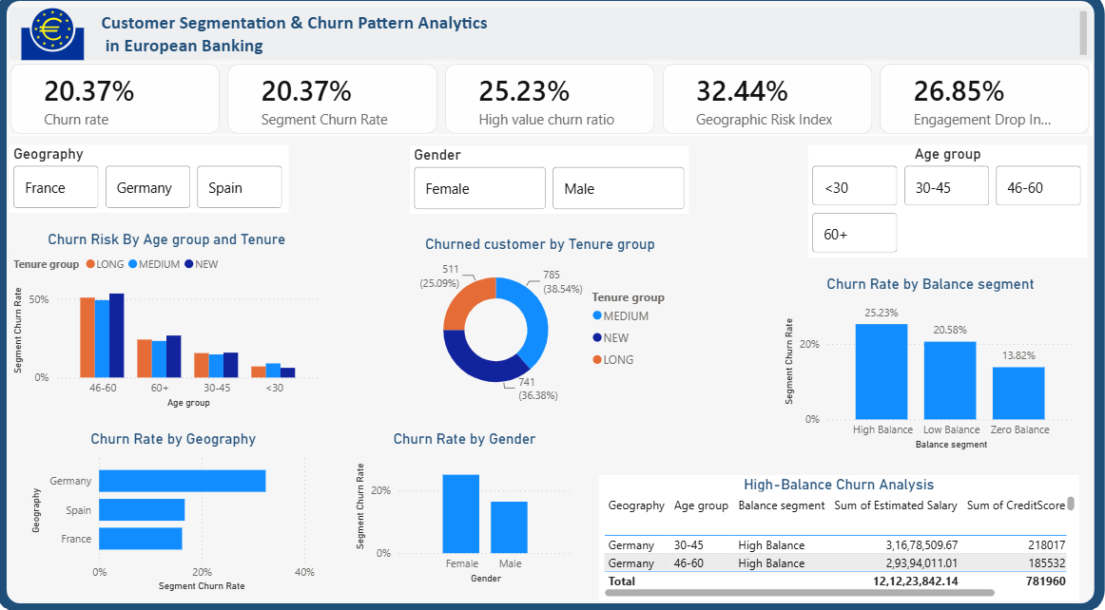
DASHBOARD OVERVIEW
The Power BI dashboard was developed to provide management with a comprehensive view of customer churn across multiple customer segments.
The dashboard consists of four major analytical sections:
Customer Retention KPIs
Customer Demographics
Customer Segmentation
Churn Distribution Analysis
The dashboard enables decision-makers to quickly identify high-risk customer groups and evaluate the impact of customer demographics on churn behavior.

Slide 10




DASHBOARD ANALYSIS
7.1 Key Performance Indicators (KPIs)
The dashboard displays four major Key Performance Indicators that summarize customer churn performance.
Overall Churn Rate (20.37%)
High-Value Customer Churn RatiO (25.23%)
Geographic Risk Index (32.44%)
Engagement Drop Indicator (26.85%)
Interpretation
The Overall Churn Rate of 20.37% indicates that approximately one out of every five customers has left the bank.
The High-Value Customer Churn Ratio suggests that customers with higher account balances are leaving at a greater rate than other customer segments, potentially resulting in a significant loss of revenue.
The Geographic Risk Index highlights variations in churn across different countries, indicating the need for region-specific customer retention strategies.
The Engagement Drop Indicator demonstrates that inactive customers are considerably more likely to churn than active customers, emphasizing the importance of customer engagement initiatives.

Slide 11
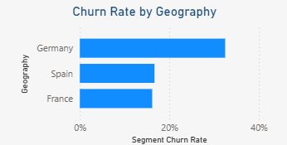
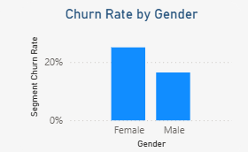
7.2 Customer Churn by Geography
The dashboard compares customer churn across France, Germany, and Spain.
Analysis
Germany records the highest customer churn rate among the three countries.
France and Spain demonstrate relatively lower churn rates.
This variation suggests that geographical factors, customer expectations, competitive intensity, or service quality may influence customer retention.
Banks should investigate customer experience and market conditions within Germany to reduce churn.
7.3 Customer Churn by Gender
The dashboard compares churn between male and female customers.
Analysis
Female customers exhibit a slightly higher churn rate compared with male customers.

Slide 12
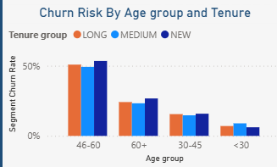
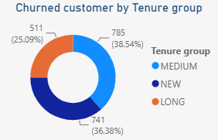
7.4 Customer Churn by Age Group
Customers were categorized into age groups to better understand demographic trends.
The dashboard indicates that customers aged 46–60 years represent the highest churn segment.
Younger customers generally display lower churn rates.
Business Interpretation
Middle-aged customers often possess larger account balances and utilize multiple banking products. Losing these customers has a greater financial impact on the bank compared with younger customer segments.
Targeted loyalty programs and personalized financial services may improve retention within this age group.
7.5 Customer Churn by Tenure
The dashboard categorizes customers based on the length of their relationship with the bank.

Slide 13
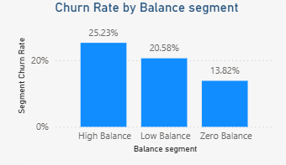
Analysis
Customers with medium tenure contribute the largest proportion of churned customers.
This suggests that customer satisfaction should be monitored continuously rather than focusing solely on new customers.
Long-term customer engagement strategies remain essential for improving retention.
7.6 Customer Churn by Balance Segment
Customers were divided into Zero Balance, Low Balance, and High Balance categories.
Analysis
High-balance customers demonstrate the highest churn ratio (25.23%).
This finding is particularly important because these customers contribute significantly to the bank's revenue.
Retaining high-value customers should therefore be considered a strategic priority.
7.7 High-Value Customer Summary
Although high-value customers represent a smaller proportion of the overall customer base, they account for a disproportionately large share of churn.
This suggests that banks should develop specialized relationship management programs and premium banking services to improve customer loyalty among this segment.

Slide 14
KEY FINDINGS
The analysis of customer churn patterns using Microsoft Power BI revealed several important insights that can support strategic decision-making within the banking sector.
8.1 Overall Customer Churn
The dashboard indicates an overall churn rate of 20.37%, meaning that approximately one out of every five customers has discontinued their relationship with the bank. This level of customer attrition represents a significant business concern, as acquiring new customers is generally more expensive than retaining existing ones.
8.2 Geographic Analysis
The geographical analysis demonstrates that customer churn varies across different regions.
Among the three countries included in the dataset, Germany records the highest churn rate, while France and Spain experience comparatively lower customer attrition.
This finding suggests that regional market conditions, customer expectations, competitive intensity, or service quality may influence customer retention.
8.3 Customer Engagement
The Engagement Drop Indicator of 26.85% highlights that inactive customers are substantially more likely to leave the bank than active customers.
Customer engagement therefore appears to be one of the strongest indicators of customer loyalty.
Banks should regularly monitor inactive customers and introduce engagement campaigns before customers decide to leave.

Slide 15
8.4 High-Value Customers
The dashboard shows a High-Value Customer Churn Ratio of 25.23%, indicating that customers with higher account balances are leaving the bank at a higher rate than expected.
This finding is particularly important because high-value customers contribute significantly to the bank's profitability.
Losing these customers can have a disproportionate impact on revenue and customer lifetime value.
8.5 Age-Based Analysis
The analysis indicates that customers between 46 and 60 years of age exhibit the highest churn rate.
This customer segment often represents financially stable individuals who maintain larger balances and use multiple banking products.
Retaining these customers should therefore become a strategic priority.
8.6 Product Ownership
Customers owning only a limited number of banking products appear more likely to churn than customers using multiple products.
Cross-selling additional banking products may therefore strengthen customer relationships and reduce the probability of customer attrition.

Slide 16
BUSINESS RECOMMENDATION
Based on the analytical findings, several practical recommendations are proposed to improve customer retention.
9.1 Strengthen Customer Engagement
Inactive customers should receive personalized engagement campaigns, including financial education, loyalty rewards, and promotional offers designed to encourage continued interaction with the bank.
9.2 Focus on High-Value Customers
Relationship managers should proactively monitor customers maintaining high account balances.
Premium banking services, exclusive benefits, and personalized financial advice may improve customer satisfaction and reduce churn.
9.3 Region-Specific Retention Strategies
Since Germany exhibits the highest churn rate, customer experience surveys and regional service improvements should be prioritized within this market.
Localized marketing campaigns may also improve customer retention.
9.4 Promote Multi-Product Adoption
Customers using only one banking product should be encouraged to adopt additional financial products such as savings accounts, loans, insurance, investment products, or credit cards.
Customers with stronger banking relationships are generally less likely to leave.

Slide 17
9.5 Continuous Dashboard Monitoring
Banks should integrate interactive Power BI dashboards into their regular business reporting processes.
Continuous monitoring of customer churn enables management to detect emerging trends and implement timely corrective actions.

Slide 18
LIMITATIONS OF THE STUDY
Although this project provides valuable business insights, several limitations should be acknowledged.
The dataset represents historical customer information and does not capture changes in customer behavior over time.
External economic factors influencing customer churn were not included.
Customer satisfaction, service quality, and digital banking experience were unavailable within the dataset.
The analysis focuses on descriptive business intelligence rather than predictive machine learning.
Future research may incorporate predictive analytics and artificial intelligence techniques to forecast customer churn more accurately.
The project can be extended by incorporating predictive analytics and advanced machine learning techniques.
Potential future enhancements include:
Customer churn prediction using Random Forest and XGBoost
Customer risk scoring models
Real-time Power BI dashboards connected to live banking databases
Integration with CRM systems for automated customer retention campaigns
Explainable Artificial Intelligence (XAI) techniques for identifying churn drivers
These improvements would enable banks to transition from descriptive analytics to proactive customer retention strategies.
FUTURE SCOPE

Slide 19
CONCLUSION
Customer retention has become one of the most important priorities within the modern banking industry. This project demonstrates how Microsoft Power BI can be effectively utilized to transform raw customer data into meaningful business intelligence.
The interactive dashboard successfully identified key customer segments with elevated churn rates by analyzing demographic, financial, and behavioral characteristics. The findings indicate that customer geography, engagement level, account balance, age group, and product ownership all influence customer retention.
The visualization of key performance indicators enables banking professionals to monitor customer behavior efficiently and make informed business decisions. By implementing targeted retention strategies for high-risk customer groups, banks can improve customer satisfaction, reduce churn, and enhance long-term profitability.
Overall, this project demonstrates the practical value of Business Intelligence tools in supporting evidence-based decision-making and strengthening customer relationship management within the banking sector.

Slide 20
REFERENCES
Microsoft Power BI documentation. https://learn.microsoft.com/power-bi/
Microsoft Power BI Desktop. https://powerbi.microsoft.com/
Unified Mentor- Customer Segmentation & Churn Pattern Analytics in European Banking: Project Guidelines. Unified Mentor Pvt. Ltd.
European Central Bank- Banking supervision and financial stability. https://www.ecb.europa.eu/

